Slide 1

EN.580.428 Genomic Data Visualization Lesson 0 Welcome and Introductions
Prof. Jean Fan

Slide 2
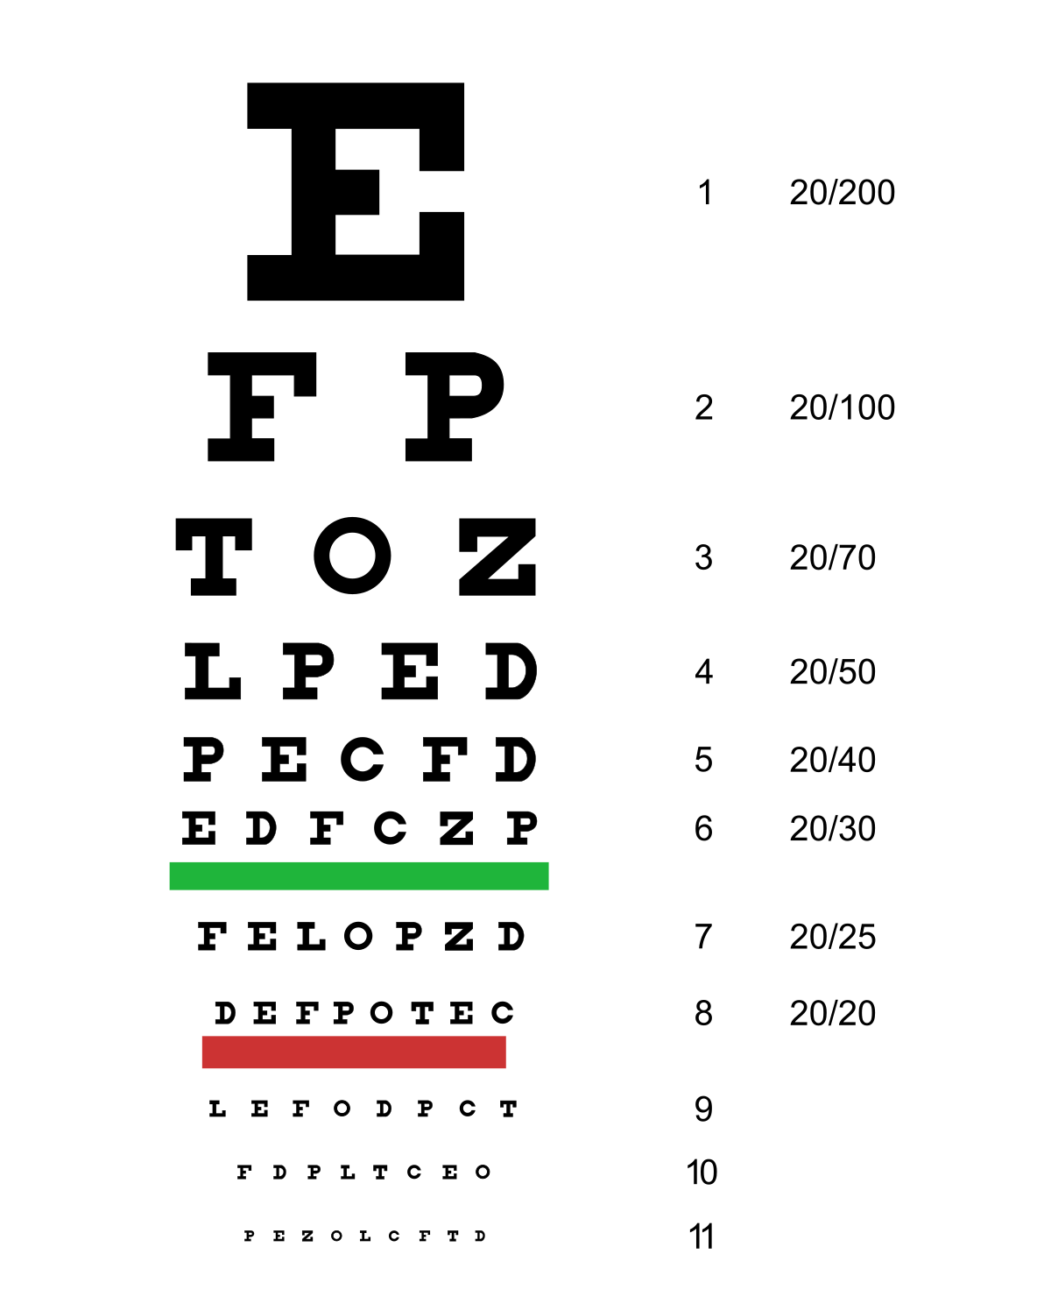
Announcements
Recording
Eyesight check
Ground rules

Slide 3
Lesson learning objectives
Set expectations
Establish a common vocabulary for discussing data visualization
To be able to communicate with each other about properties of data visualization
Be interactive
Make sure you know how to submit your HW

Slide 4
Course website
https://jef.works/genomic-data-visualization-2026
Canvas: https://jhu.instructure.com/courses/114937

Slide 5
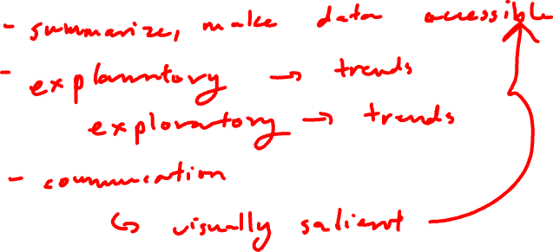
What is data visualization?

Slide 6
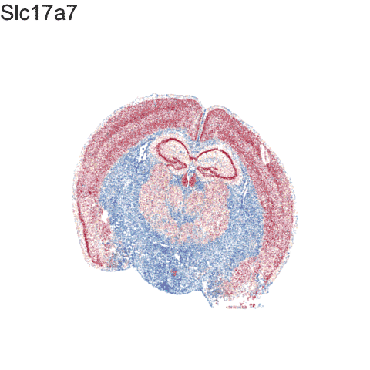
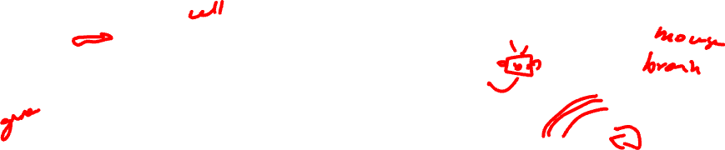
What is data visualization?
Data visualization == “the graphical display of data”

Slide 7
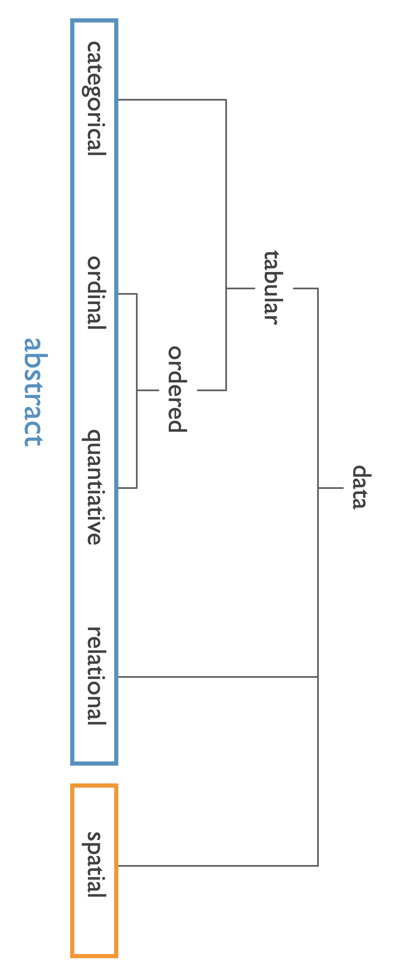
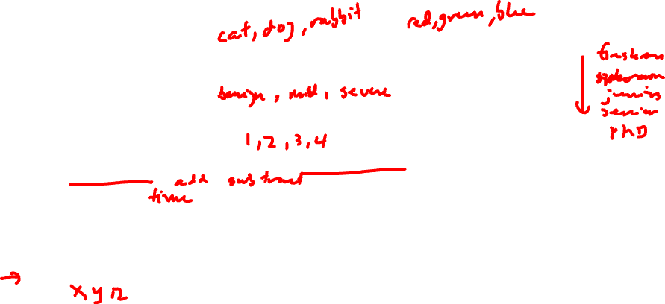
Data types
Categorical data represent qualitative characteristics. Categorical data can take on numerical values, but those numbers don’t have mathematical meaning.
Ordinal data represent mixes numerical and categorical data. The data fall into categories, but the numbers placed on the categories have meaning.
Quantitative data represent numerical values. Values can be interpreted mathematically.
Relational data represent how numerical and categorical data are related
Spatial data represents information about the physical location and shape

Slide 8
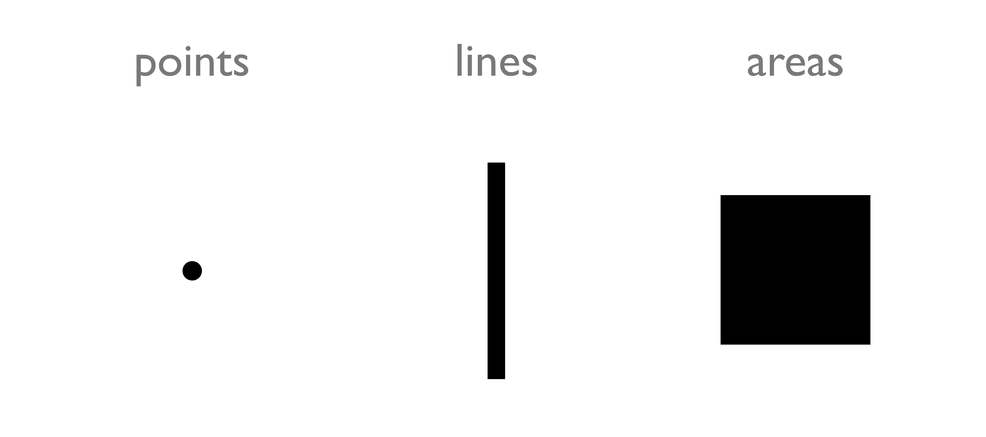
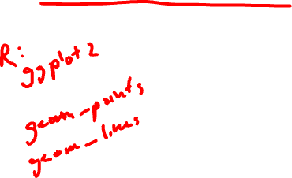
Types of encodings for different data types: Geometric Primitives
(Credit: Nils Gehlenborg, ISMB/ECCB 2011)

Slide 9
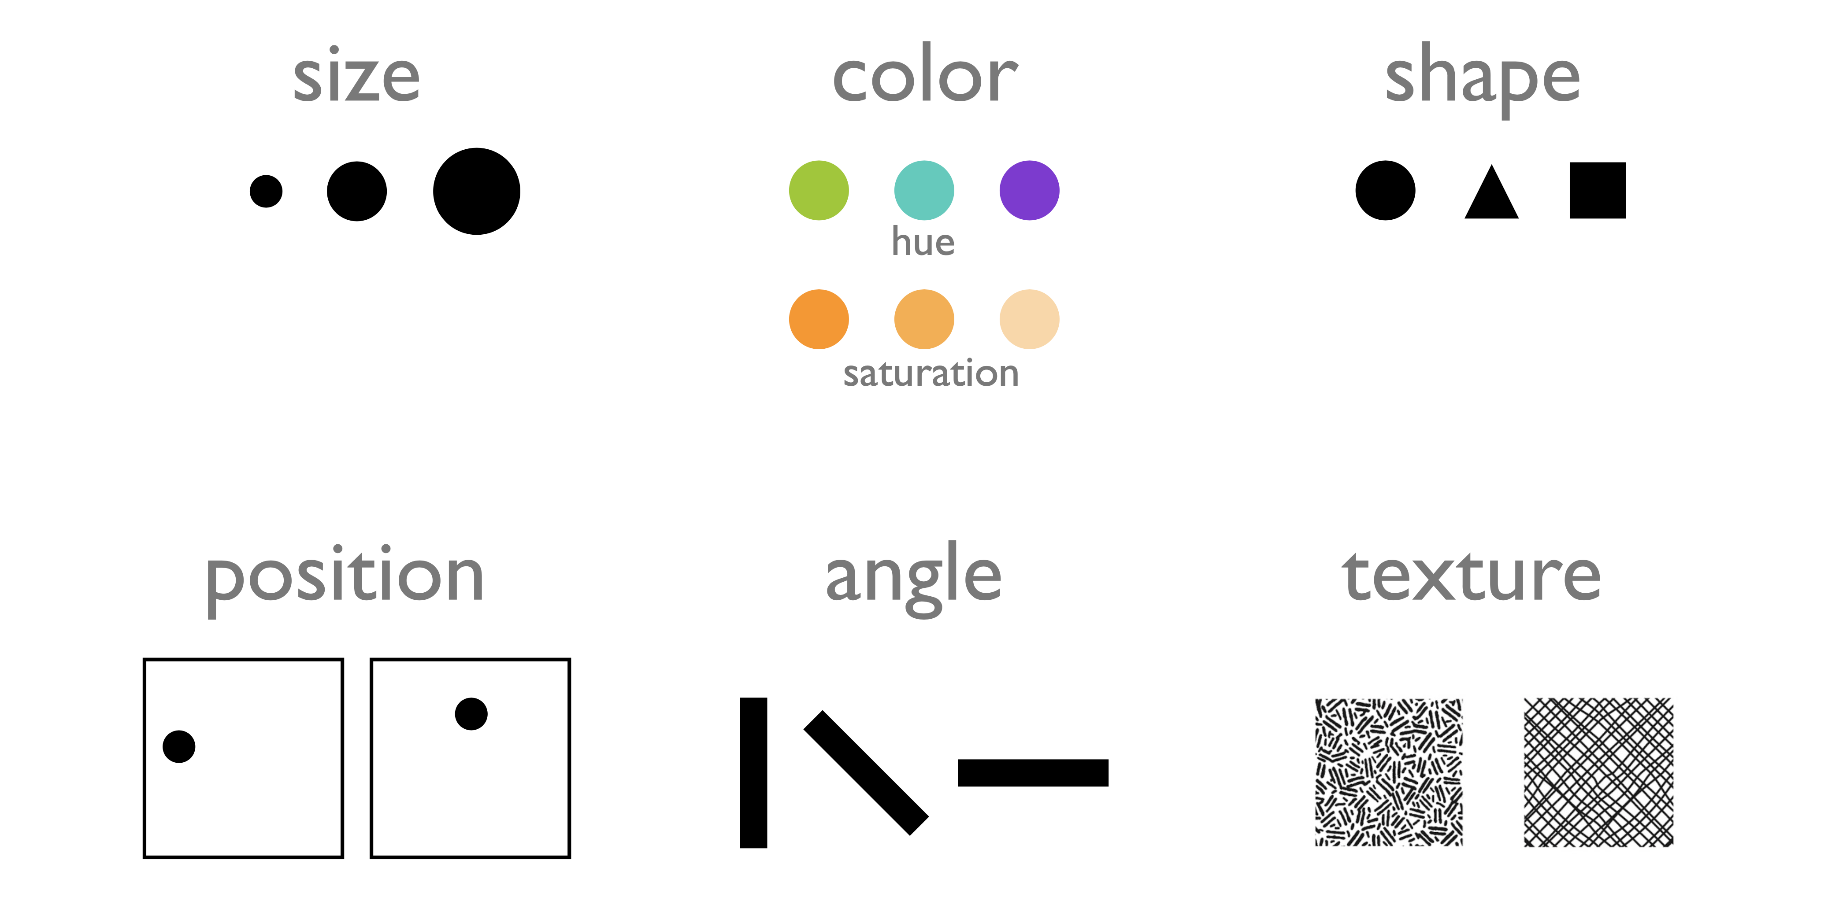
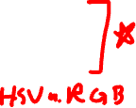
Types of encodings for different data types: Visual Channels (control geometric primitives)
(Credit: Nils Gehlenborg, ISMB/ECCB 2011)

Slide 10
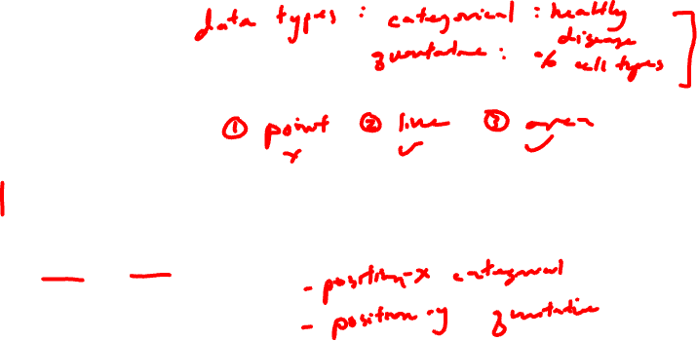
Data visualizations use combinations of geometric primitives and visual channels
Practice
Geometric primitive:
Visual channels:

Slide 11
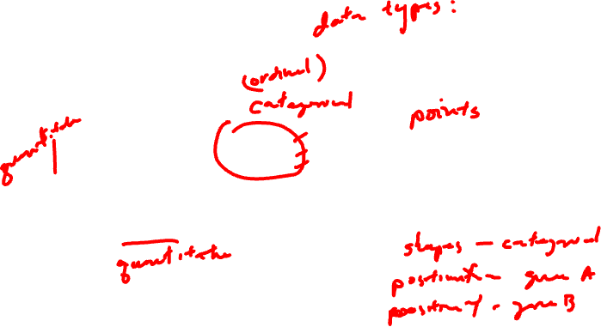
Data visualizations use combinations of geometric primitives and visual channels
Practice
Geometric primitive:
Visual channels:

Slide 12
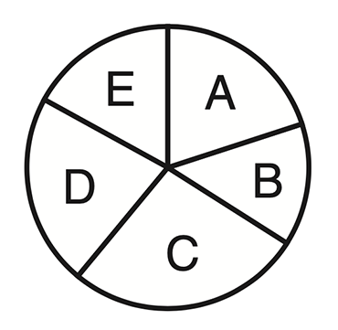
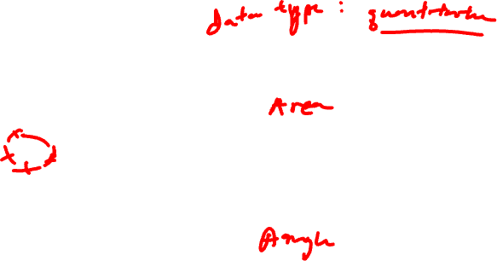
Data visualizations use combinations of geometric primitives and visual channels
Practice
Geometric primitive:
Visual channels:

Slide 13

Gestalt Principles
Gestalt Principles are an essential part of visual design (generally, not just data visualization)
There are more than ten overlapping principles
We will focus a few most applicable to data visualization
Basic on perception and cognitive psychology research

Slide 14

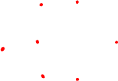
Gestalt Principle: Similarity
Items alike in their properties (size, shape, color, and so on) tend to be perceived as being a related group

Slide 15

Gestalt Principle: Similarity
Practice
Items alike in their properties (size, shape, color, and so on) tend to be perceived as being a related group
How does this data visualization use the Gestalt principle of similarity?

Slide 16
Gestalt Principle: Proximity
Items are near each other tend to be perceived as being a related group

Slide 17

Gestalt Principle: Proximity
Practice
Items are near each other tend to be perceived as being a related group
How does this data visualization use the Gestalt principle of proximity?

Slide 18
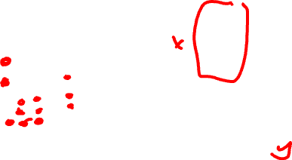
Gestalt Principle: Enclosure
Items surrounded by something such as a line or an an object tend to be perceived as being a group

Slide 19

Gestalt Principle: Enclosure
Practice
Items surrounded by something such as a line or an an object tend to be perceived as being a group
How does this data visualization use the Gestalt principle of enclosure?

Slide 20

Gestalt Principle: Enclosure
Practice
Items surrounded by something such as a line or an an object tend to be perceived as being a group
How does this data visualization use the Gestalt principle of enclosure?

Slide 21
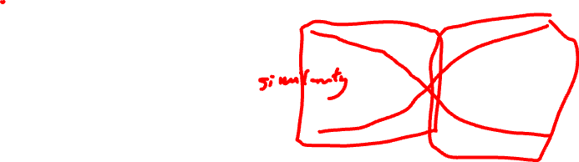
Gestalt Principle: Continuity
Elements tend to be perceived as smooth groups or continuous lines rather than sharp broken lines

Slide 22


Gestalt Principle: Continuity
Practice
Elements tend to be perceived as smooth groups or continuous lines rather than sharp broken lines
How does this data visualization use the Gestalt principle of continuity?

Slide 23
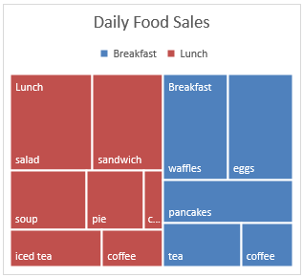
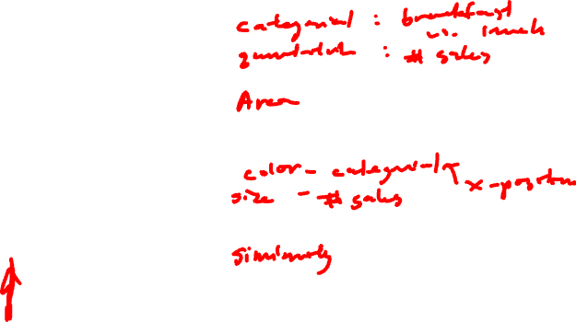
Data visualizations use combinations of geometric primitives and visual channels
Practice
Data Type:
Geometric primitive:
Visual channels:
Gestalt principles:

Slide 24
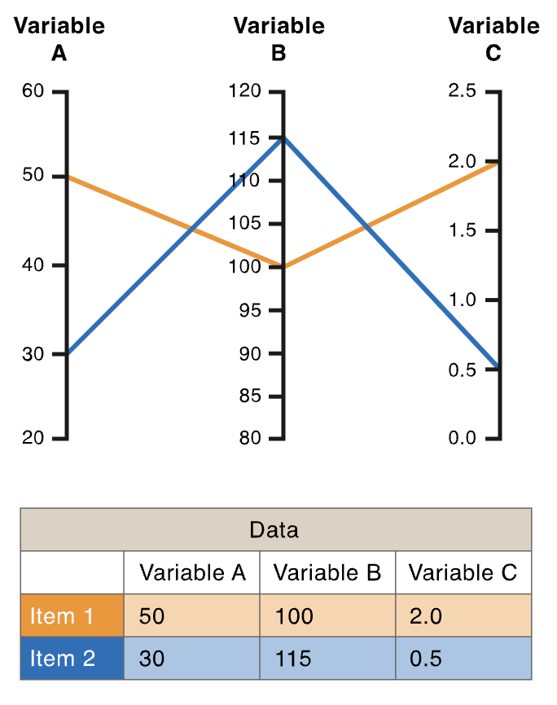
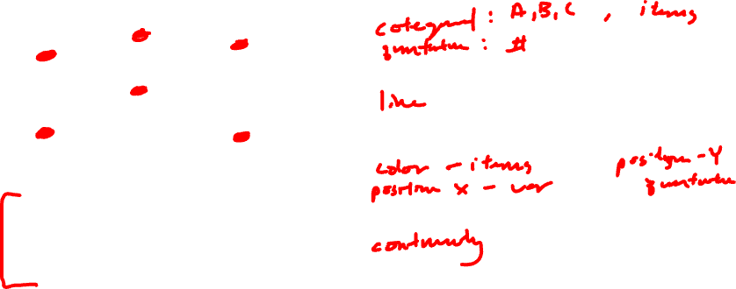
Data visualizations use combinations of geometric primitives and visual channels
Practice
Data Type:
Geometric primitive:
Visual channels:
Gestalt principles:

Slide 25
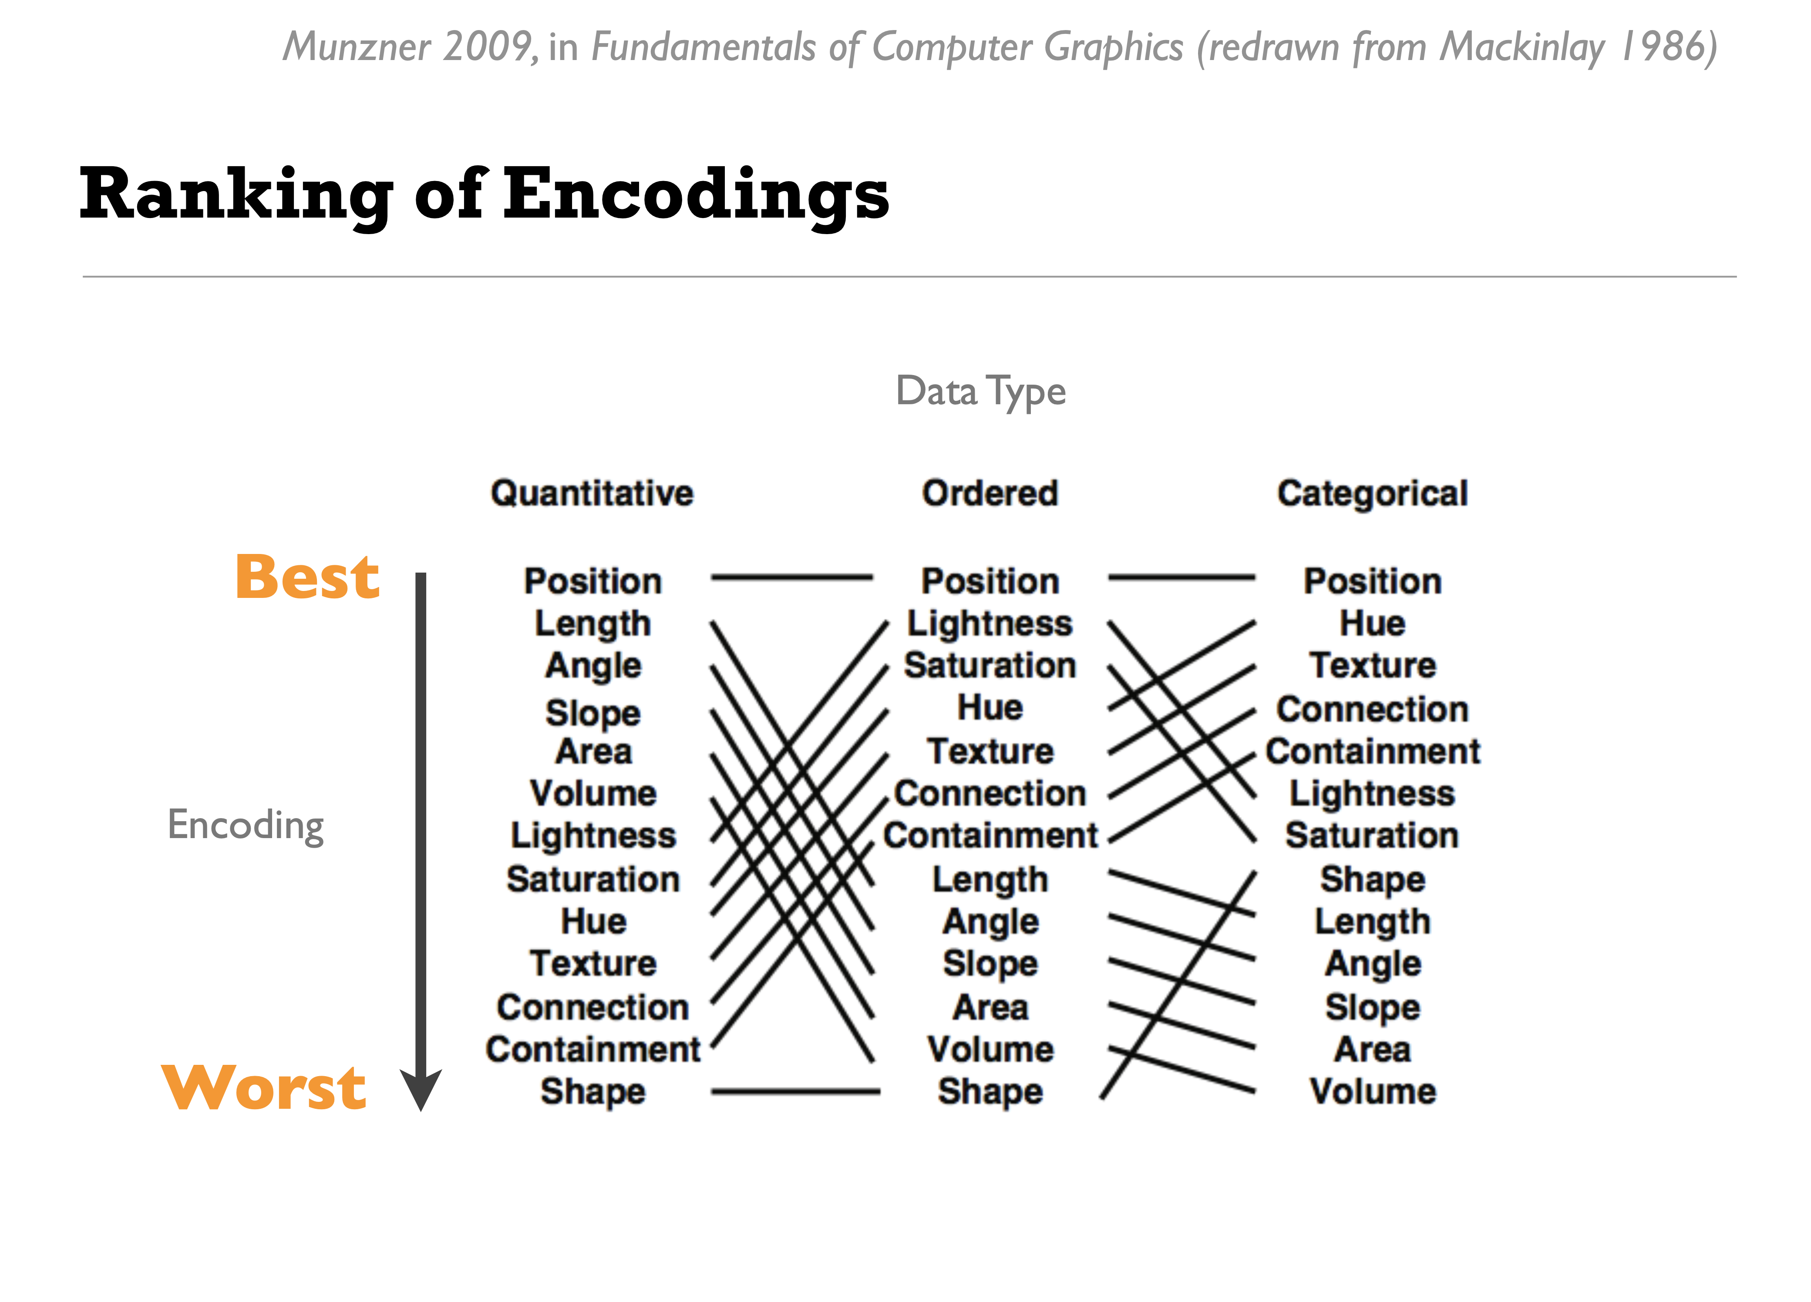
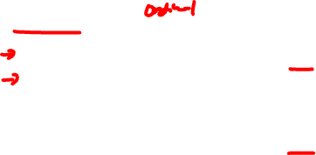
Human perception has a harder time resolving certain data encodings for different data types
(Credit: Nils Gehlenborg, ISMB/ECCB 2011)

Slide 26
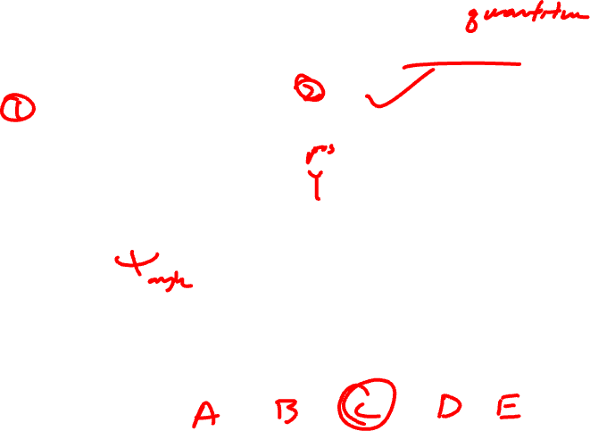
Demo: Which letter is more common?
(Credit: Bang Wong, Nature Methods, 2010)
Notes:
Different graph types depend on different visual assessments to uncover underlying trends. Pie charts are a common way to show parts of a whole. Most readers will likely judge angle when extracting information from pie charts, but they could also com- pare areas and arc length of the slices. Plotting the same data as a bar chart effectively shows relative values.

Slide 27
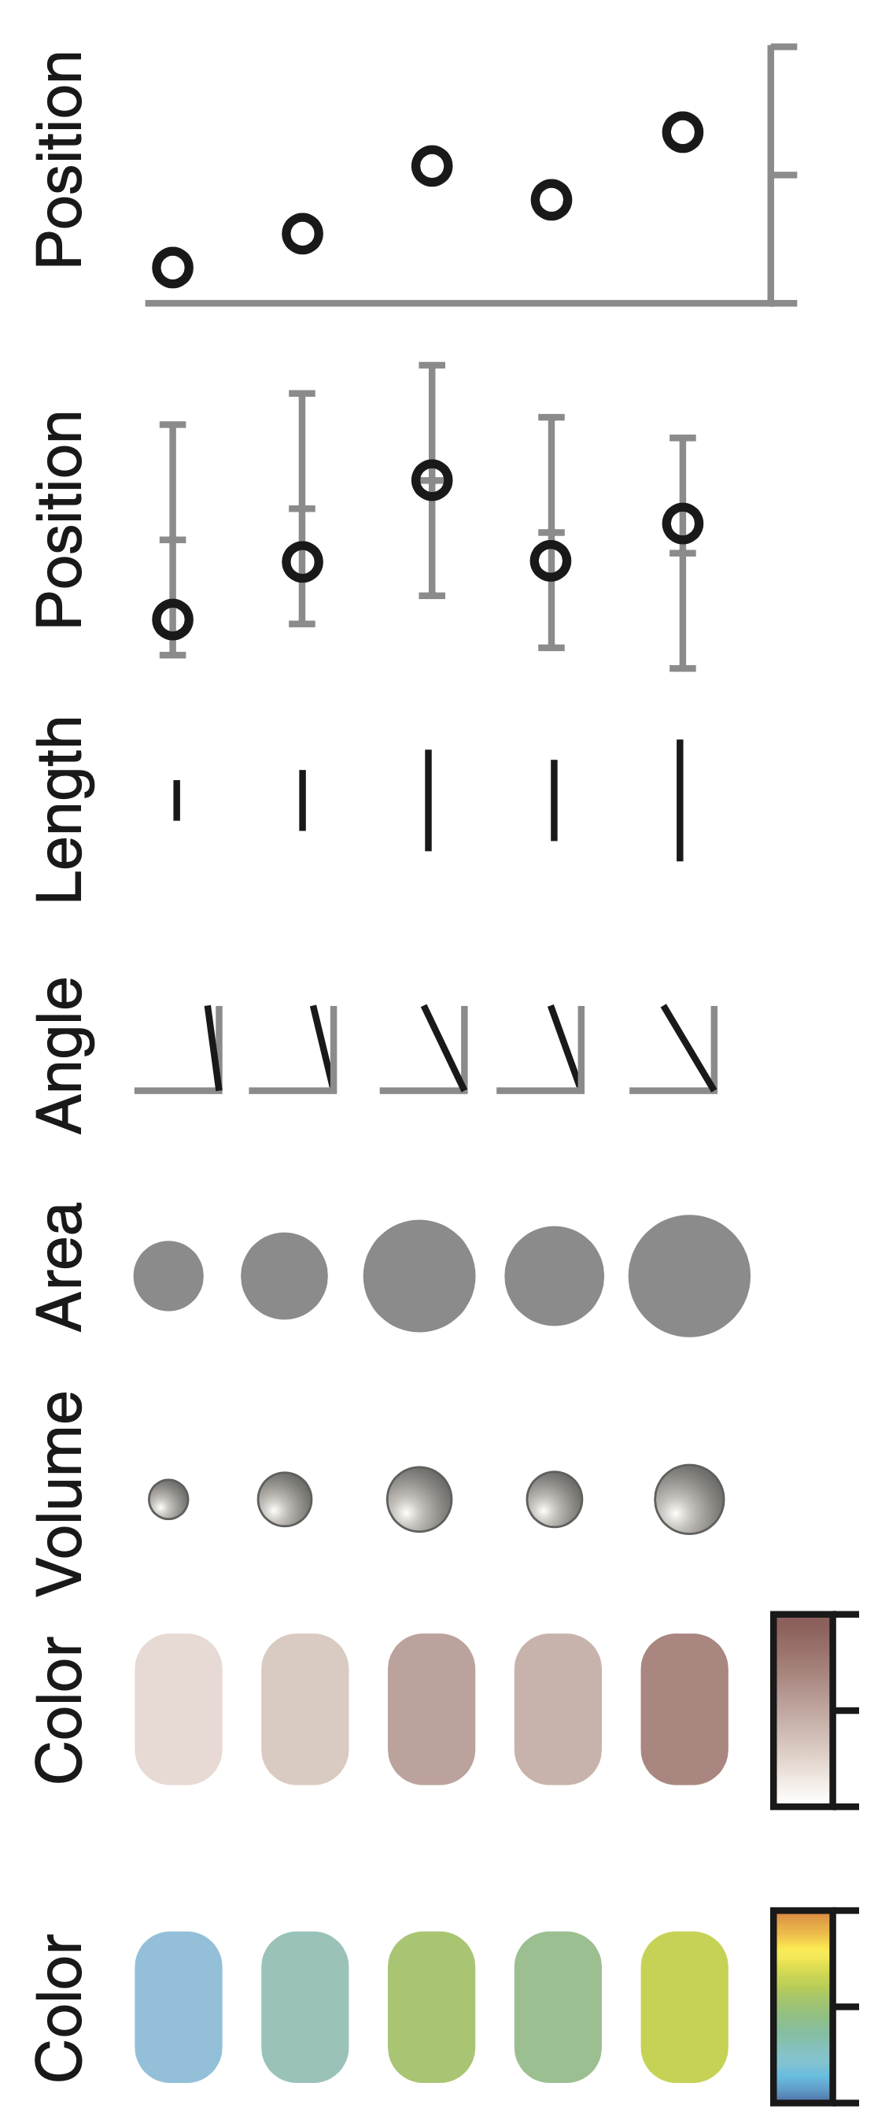
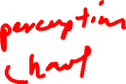
(Credit: Bang Wong, Nature Methods, 2010)

Slide 28
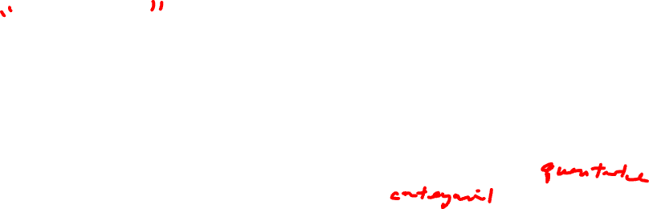
Salience
Salience (in data visualization) is how the viewer's eye is drawn to what is important in the data visualization
Enhanced saliency improves viewer understanding of the data
How accurately can the data be read from the visualization?
How many classes can be distinguished?
Can the visual properties and geometric primitives be separated from each other?
Which visual properties and geometric primitives are processed preattentively?
Which visual properties and geometric primitives encode more important information more effectively?
A good data visualization enhances saliency

Slide 29
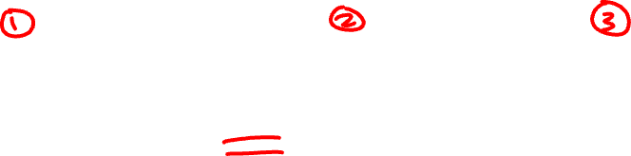
How do these different data visualizations enhance saliency of different features?
Practice

Slide 30
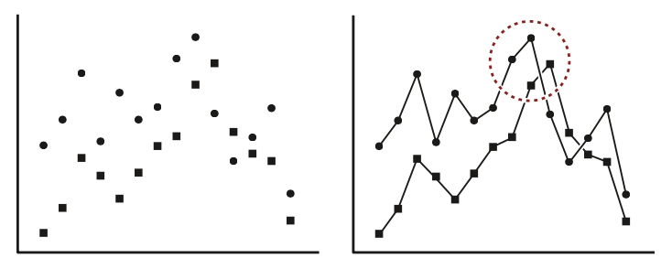
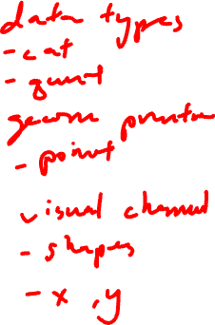
What’s your interpretation of this data visualization?
Practice

Slide 31
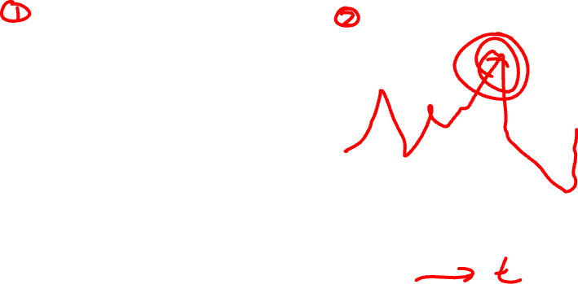
What about this one?
Practice
What gestalt principals are being applied?

Slide 32
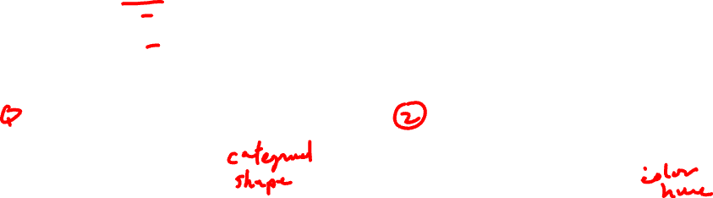
Practice
Which data visualization do you prefer? Why?

Slide 33
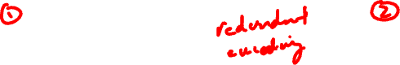
Practice
Which data visualization do you prefer? Why?

Slide 34
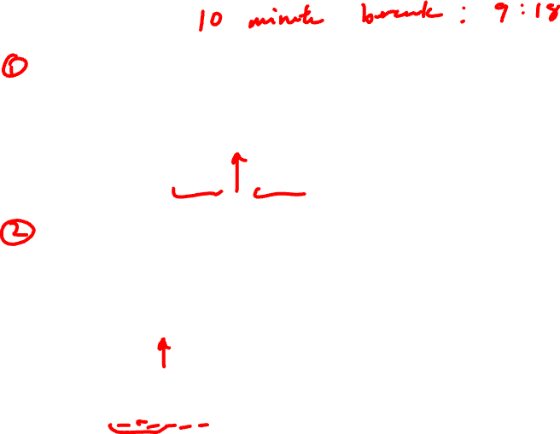
Practice

Slide 35
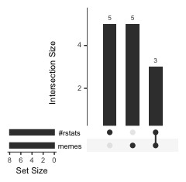
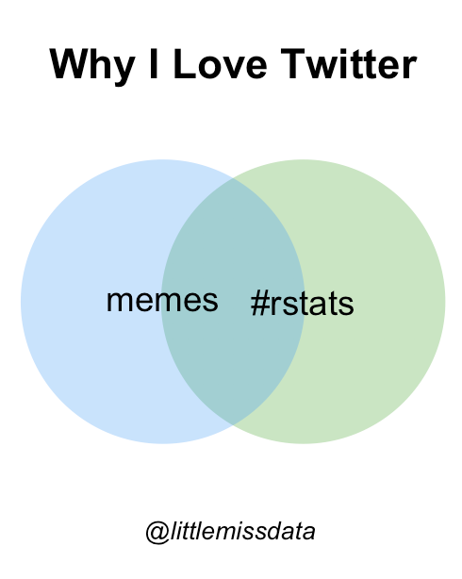
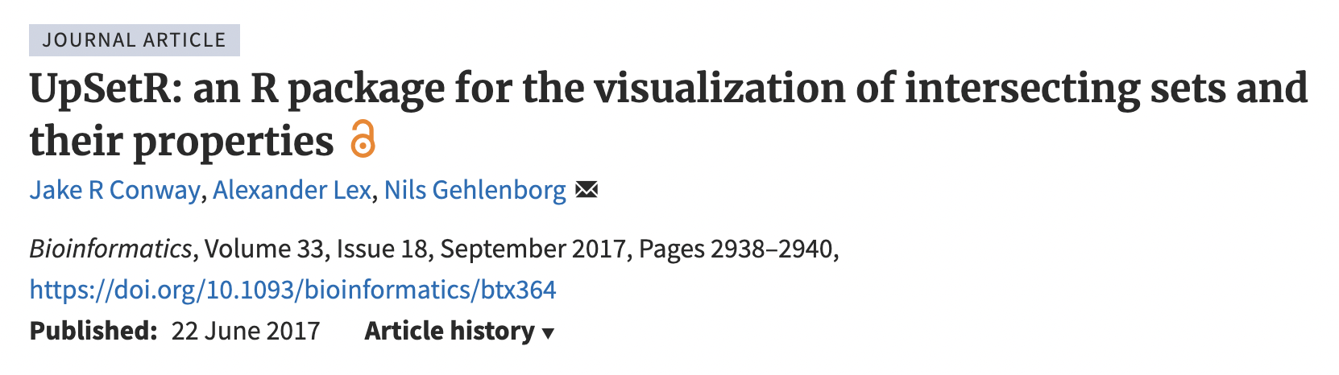
Which data visualization do you prefer? Why?
Practice
 | Memes | #Rstats
Student 1 | 1 | 0
Student 2 | 1 | 0
Student 3 | 1 | 0
Student 4 | 1 | 0
Student 5 | 1 | 0
Student 6 | 0 | 1
Student 7 | 0 | 1
Student 8 | 0 | 1
Student 9 | 0 | 1
Student 10 | 0 | 1
Student 11 | 1 | 1
Student 12 | 1 | 1
Student 13 | 1 | 1
https://www.littlemissdata.com/blog/set-analysis

Slide 36
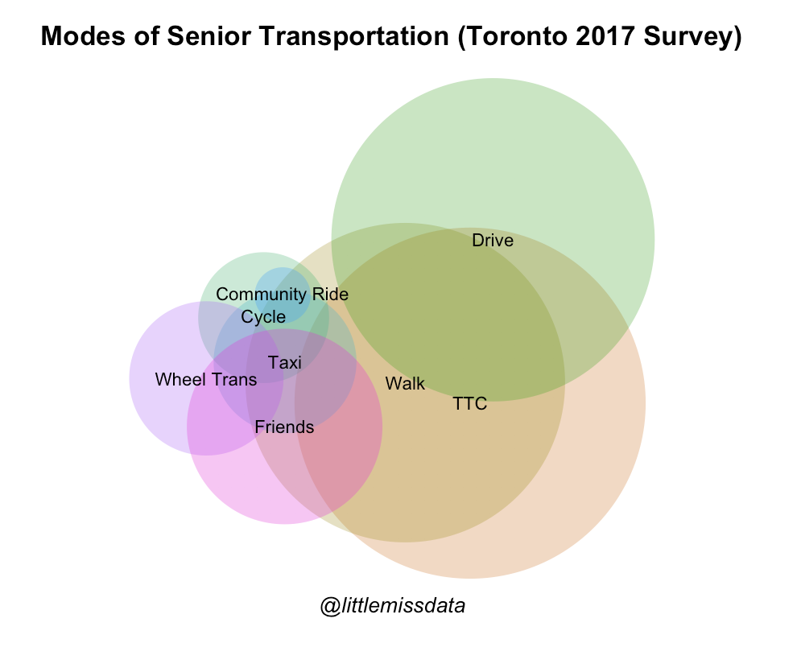
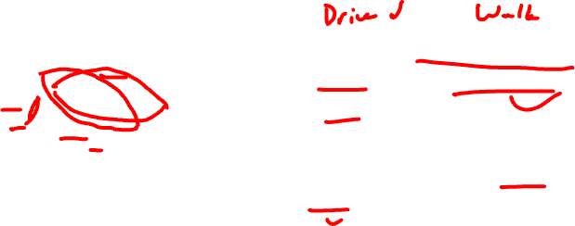
Which data visualization do you prefer? Why?
Practice
Do more seniors drive or walk?
Do more seniors walk AND drive only or TTC and drive only?
Do more seniors cycle only or taxi only?
https://www.littlemissdata.com/blog/set-analysis

Slide 37
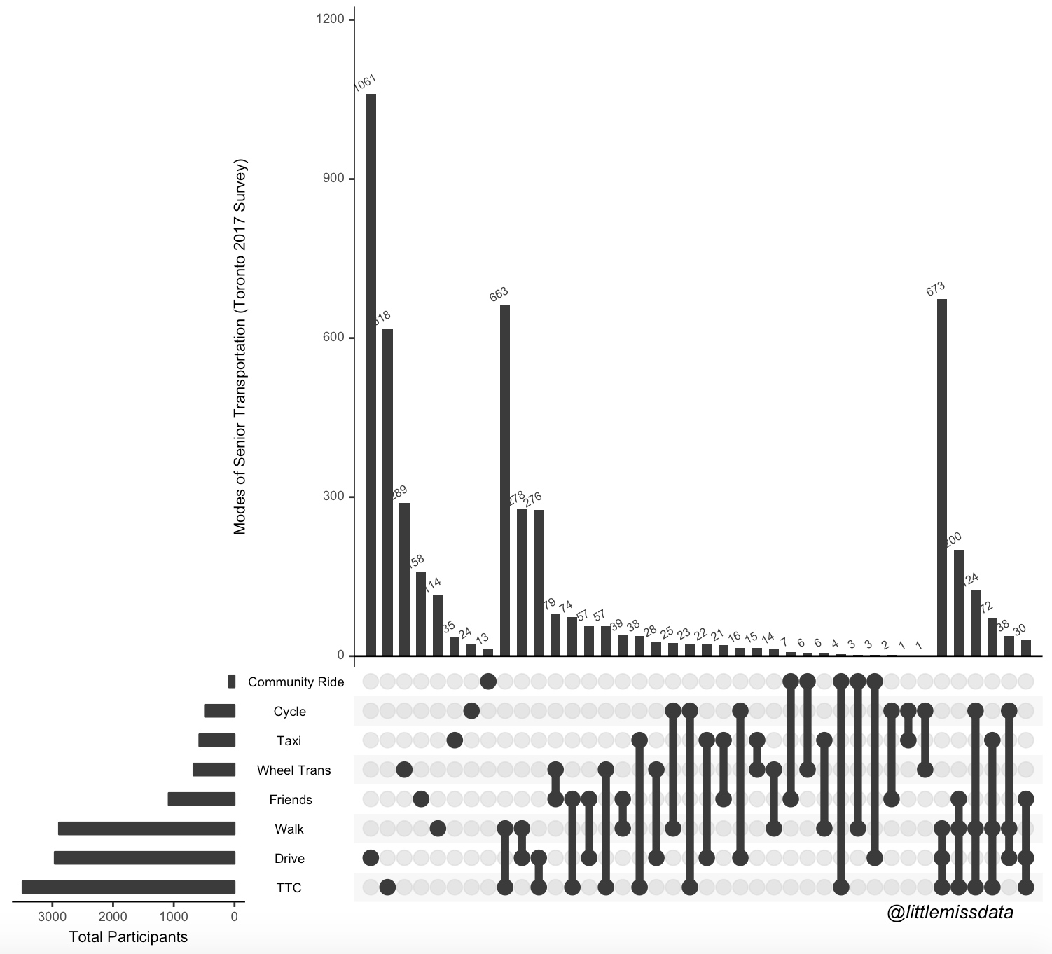
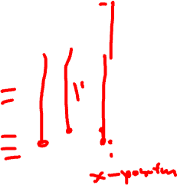
Practice
Do more seniors drive or walk?
Do more seniors walk AND drive only or TTC and drive only?
Do more seniors cycle only or taxi only?

Slide 38
Practice
https://www.littlemissdata.com/blog/set-analysis

Slide 39
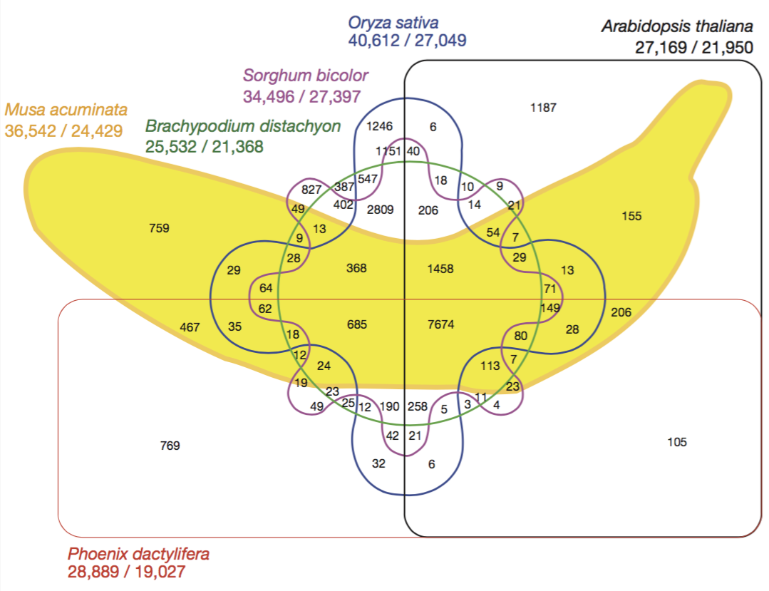
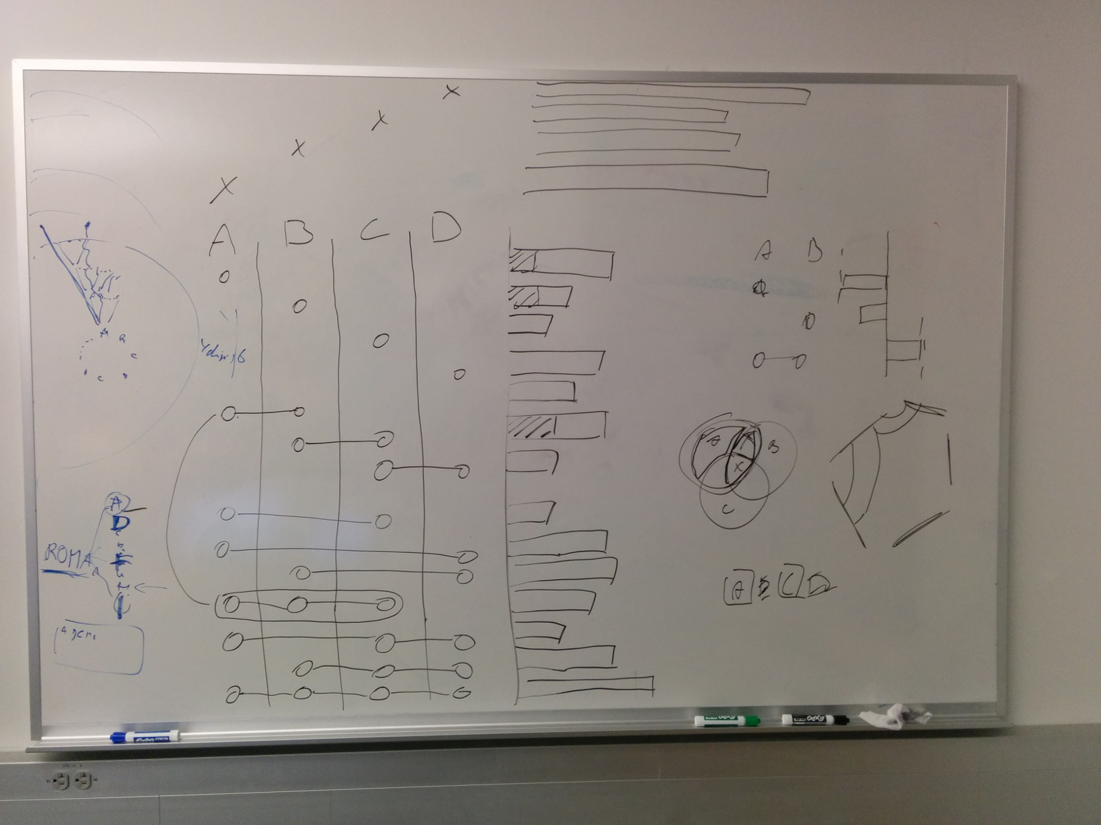
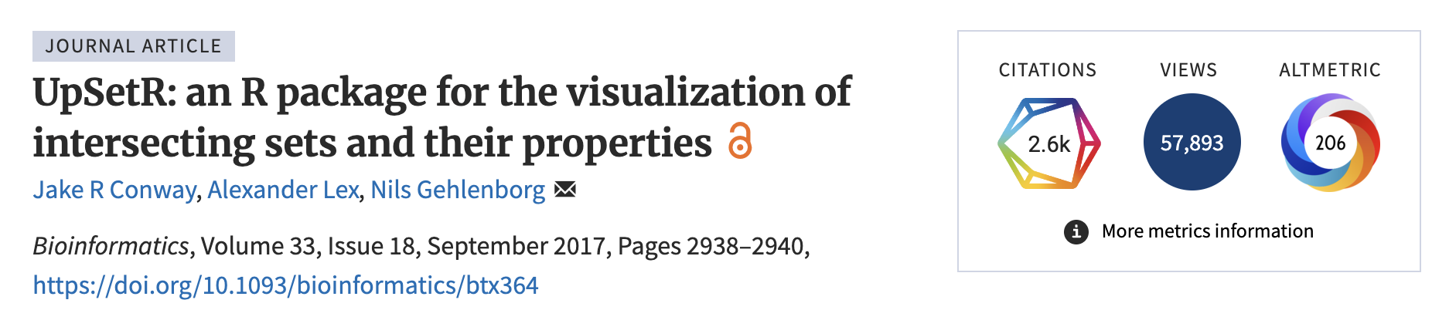
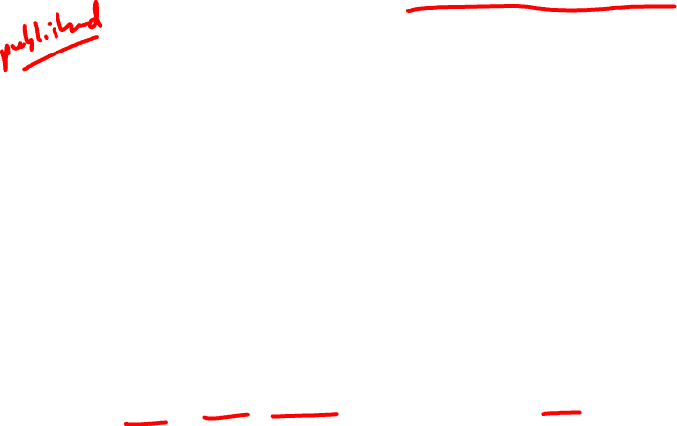
Fun background: https://upset.app/about/

Slide 40

10 Minute Break
Start HW0
Reflection Cards

